Slide 1
Knowledge Base
Names :-
Mostafa Tarek Gaber
Mohamed Omar
Basel Ahmed
Names :-
94071
94114
98052

Slide 2
Problem Statement:-
The knowledge is the power of our century
With Knowledge we can do any things
Knowledge gives us new technologies

Slide 3
How to manipulate knowledge
Step 1 :- collect data (facts)
Step 2 :- use facts to extract information
Step 3 :- use information to build knowledge base
Step 4 :- manipulate knowledge
Step 5 :- make knowledge representation easier to use

Slide 4
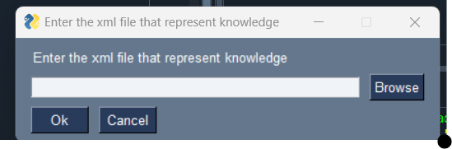
What we made :- choose xml file that store your Knowledge

Slide 5
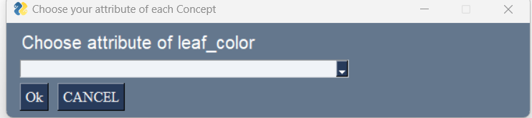
After that:-
Choose your attributes of your concepts to know your Rule

Slide 6
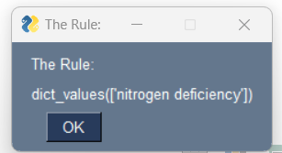
After you choose right attributes :- the Rule will show

Slide 7
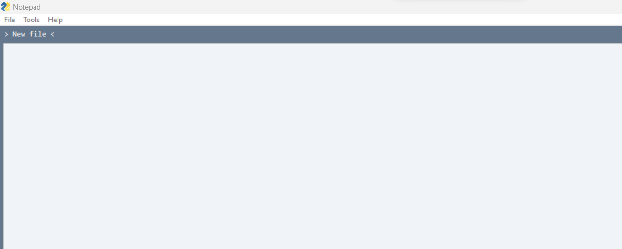
You also can edit xml file or create new or open it to show

Slide 8
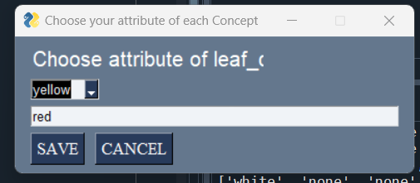
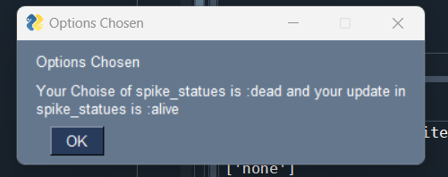
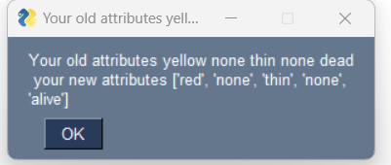
You can edit your knowledge that you represented in xml file

Slide 9
Refrences
www.geeekstogeeks.com/khaled
www.geekstogeeks.com/ahmed

